Slide 1
Occlusion Handling in Behavior Planning using Imitation Learning Master Thesis by: Janaranjani Palaniswamy

Slide 2
Overview
Project Motivation and Objective
Introduction
Proposals
Implementation and Results
Conclusion

Slide 3
Project Motivation
Planning is very important for safe navigation of autonomous driving vehicles (AV).
Behavior planning involves making tactical driving decisions like distance keeping, neighboring vehicle interactions.
Real-world environment with roundabouts pose an exciting challenge in autonomous driving.
An oncoming vehicle has to estimate whether it may enter without hindering the circulating traffic.
Uncertainties in the form of occluded regions play a major role.
Occlusions limits the visibility of the AV.
Risk of collision with other traffic participants.
For more project-related info, please contact Maxim Dolgov (maxim.dolgov@de.bosch.com) or Martin Stoll (martin.stoll@de.bosch.com)

Slide 4
Project Objective
Goal is to handle the risk of occluded environment and select optimal acceleration for driving along a pre-defined route while preventing crashes.
Implementation of algorithm to include occlusions in the environment.
Approach to enhance the policies to exhibit better performance that is robust enough.
Make use of input in top-down representation to aid easy testing and validation with real or simulated data.

Slide 5
Project Motivation and Objective
Introduction
Proposals
Implementation and Results
Conclusion

Slide 6
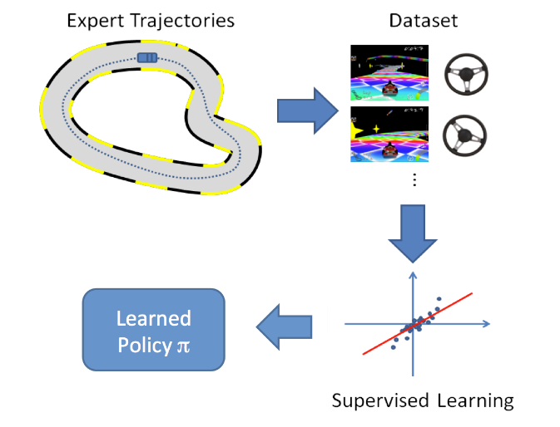
Imitation Learning
Introduction
Technique aims to mimic human behavior.
An expert is used to demonstrate the desired behavior and the agent tries to learn an optimal policy that solves the given task.
Agent is the AV that navigates through environment and perceives information.
Policy is a function that maps a state to an action.
Agent uses to decide which action to execute when presented with a situation.

Slide 7
Workflow
Introduction
Actions
Observations
Dataset
Simulation
Environment
(Highway env)
Rollouts
Training Pipeline
Policy
Losses
Evaluation Pipeline
Scenarios
Metrics
Expert
Notes:
Notes
Highway env simulation environment
Gives the data from perception system
Expert acted in environment generates full sequence of observation called rollout.
Rollout = A rollout usually comprises data of one scenario with nonzero duration, e.g. drive through an intersection or overtake on highway. It contains perception output in the form of object lists including ego state.
Dataset = feature –label pairs of all time steps for specified rollout
Feature = feature is grid map
Label = output of policy – waypoints or low-level controls (acceleration and steering angle)
Evaluation = roll policy the policy on env, and observe the results of the policy behaviour.

Slide 8
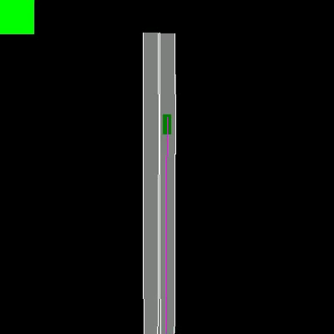
Simulation Environment
Introduction
Simulator that allows for playing back real trajectories is used.
Enables simulating the movement of controlled vehicles given actions selected by a policy.
Simulation Environment
Notes:
In order to learn the policy in an environment with human drivers.

Slide 9
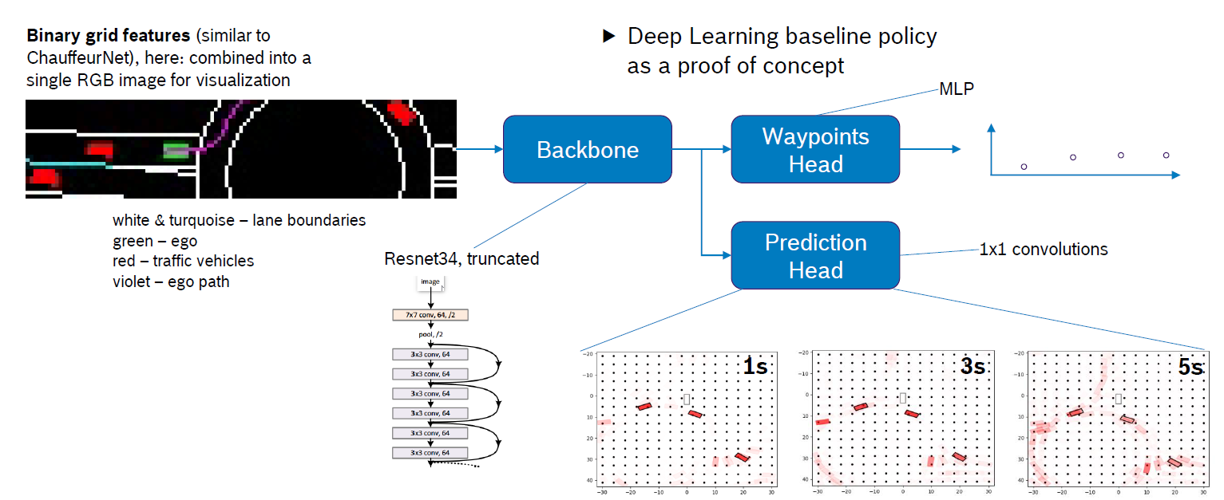
Policy
Introduction
Policy Architecture
Notes:
The network takes top-down input repsentation and outputs a drivable trajectory point.
Different layers are lane boundaries, road surface, ego vehicle, traffic and planned path layer

Slide 10
Closed Loop Evaluation
Introduction
Replay the segment through the simulation and generate model input.
The model is evaluated on this input, and the fitted controls are passed to the vehicle simulator thus moving the simulated agent to its next pose.
Evaluate on scenario specific metrics like stopping for a stop-sign, collision with another vehicle etc. during the simulation.
Since the model is being used to drive the agent forward, this is a closed-loop evaluation setup.
Notes:
1. To evaluate our learned model on a specific scenario, we replay segment
2. This allows us to generate the first rendered snapshot of the model input using all the replayed messages until now.

Slide 11
Project Motivation and Objective
Introduction
Proposals
Implementation and Results
Conclusion

Slide 12
Methodology
Proposals
Develop an algorithm to induce the occluded region in the environment.
Change the data generation model (expert) to handle occlusions.
Generate simulation data to train the policy
Enhance the visibility of the policy by adding visibility layer to grid input data.
Hyperparameter tuning using AutoML.
Notes:
To achieve the objective

Slide 13
Project Motivation and Objective
Introduction
Proposals
Implementation and Results
Conclusion

Slide 14
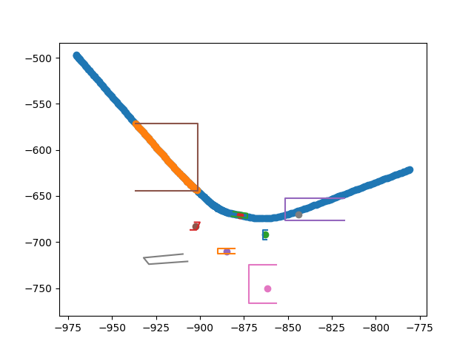
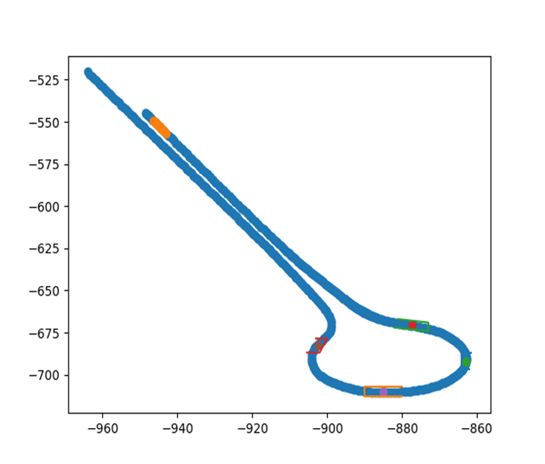
Occlusion Algorithm
Implementation
Fixed occlusion zones in the roundabout.
Algorithm to remove the object that appear inside the fixed zones called as object filter.
Dynamically activate the occlusions based on ego positions.
Fixed occlusion zones
Dynamic occlusion zones

Slide 15
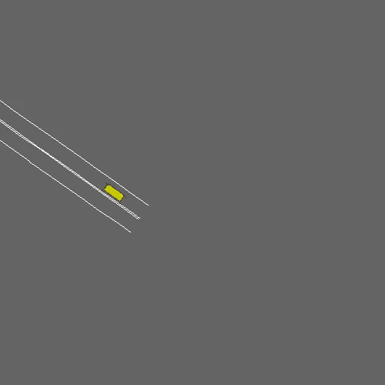
Environment Adaptation
Implementation
Include object filter in the environment.
Filters the vehicles in certain regions.
Environment with fixed -occlusion zones

Slide 16
Expert
Implementation
As the environment filters certain objects (vehicles), expert has limited visibility.
Enable the expert to hallucinate about the hidden objects.
New expert enforces regulatory rules to check collisions with hidden objects as well.
Expert recalculates the acceleration and steering angle accordingly.

Slide 17
Evaluation
Implementation
Metrics
Most important KPIs
Ratio successful rollouts
Ratio of rollouts ending in collision
Expert evaluation required a new metric definition
Maximum deceleration during braking (m/s^2)
Detailed evaluation of Expert.
Baseline – Default underlying expert
Limited visibility – Environment with occlusions and has no idea about vehicles inside occlusion zones
Full idm – new model with visibility to vehicles inside occlusion regions through spawning

Slide 18
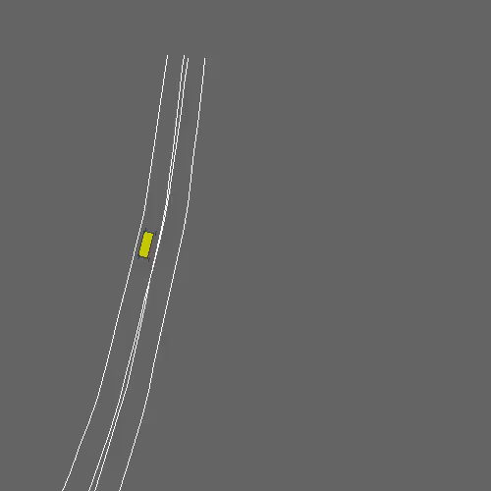
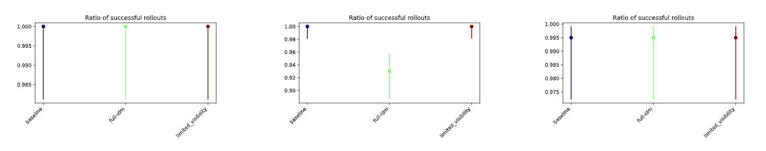
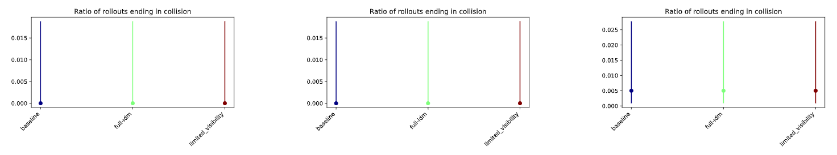
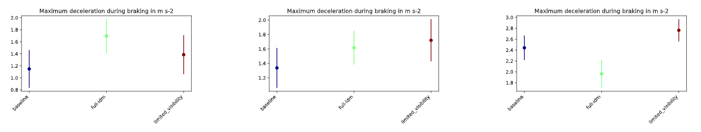
Scenario_empty
Expert Evaluation
Full-IDM model – empty scenario
Notes:
Empty:
All the experts has full success ratio, which indicates there is no collision.
Yielding:
The models are good enough and on bar with baseline model

Slide 19
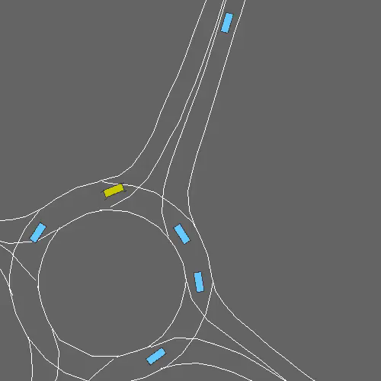
Scenario_general
Expert Evaluation
Full-IDM model – general scenario
Notes:
General scenario:
Full idm has lower success ratio
and on bar with baseline model

Slide 20
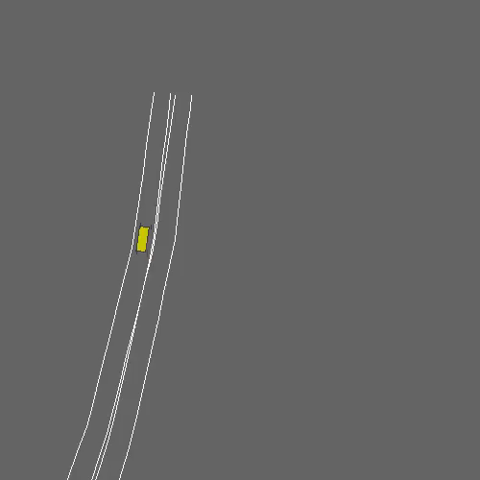
Scenario_yielding
Expert Evaluation
Full-IDM model – yielding scenario
Notes:
Yielding:
The models are good enough and on bar with baseline model

Slide 21
Policy Study
Generated dataset from simulation environment using object filters.
Trained the policy with new dataset.
Evaluated the policy with default environment and new occluded environment.
Default dataset | Object_filter dataset
features_generator_config -> No ObjectFilter (all objects visible) | features_generator_config -> OcclusionZones ObjectFilter (some objects hidden)
Notes:
Trained the policy using dataset with hidden objects

Slide 22
Policy Training
Policy Study
Policy used - (FlexibleCnnBackboneWaypointsDetectionHead)
Config | No_filter policy | Filter policy
Dataset | Default dataset (without object filter) | Object filter dataset
Evaluation | Default environment, | Default environment,
 | Occlusion environment | Occlusion environment
Default dataset + default environment = baseline of the project

Slide 23
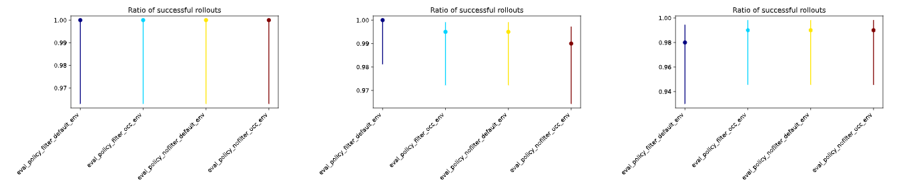
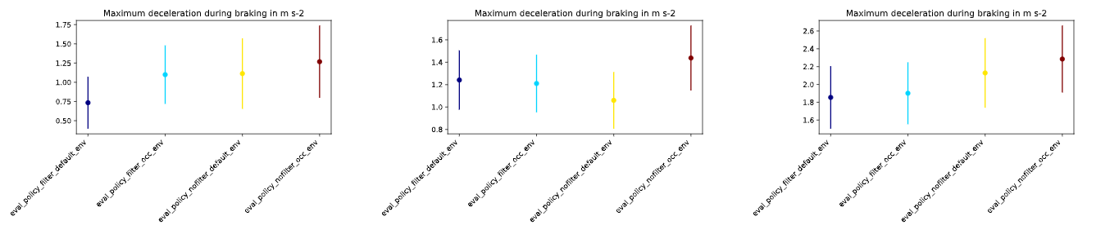
Policy Evaluation
Policy Study
Scenario_layeredmap_empty
Scenario_layeredmap_general
Scenario_layeredmap_yielding
Notes:
There is no evidential pitfalls observed between default and occlusion environment.
As the occlusion region is active for shorter duration, policy sees all the objects

Slide 24
Project Motivation and Objective
Introduction
Proposals
Implementation and Results
Conclusion

Slide 25
Summary
Presented an approach using object filters to include occluded region based on ego position.
Designed a new expert model to handle the risk of occlusions.
Model performs yielding action in a more careful way.
Trained the policy using dataset with hidden objects.
Evaluation study on policy model on default and occluded environment.
No evidential difference between two environment.

Slide 26
Future Work
More refinement on trigger zones required to keep alive occlusions for longer period.
Add a visibility layer to the grid map to make the policy learn the occluded regions.
Perform closed loop evaluation.
Hyperparameter optimization.
Detailed ablation study of the policy model.

Slide 27
Thank You

Slide 28
Object Filter

